Slide 1
FLS Unit 6
Justin Ehly, DS 6306 Tu-630p

Slide 2
For Live Session: Part 1 (3-5 hours)
Download the training set: Connect to the opendatasoft website and download the random sample of 891 Titanic Passengers. This is the training set. The data come in JSON form format and you can use this URL to access the data:
https://public.opendatasoft.com/api/records/1.0/search/?dataset=titanic-passengers&rows=2000&facet=survived&facet=pclass&facet=sex&facet=age&facet=embarked
Hint: This is not trivial. I recommend that you use the jsonlite package (fromJSON()) and RCurl package (getURL()) to access the data. (We covered this in Unit 4).
Try your best to access the data using the URL. You may also find the data (titanic_train.csv) on github. We will go over this data ingestion in live session.
Use KNN to classify those who survived and died based on Age and class.
Use your age and predict your survival based on each of the ticket classes.
Use your model to classify the 418 randomly selected passengers in the test set (titanic_test.csv) on github.
Create a confusion matrix and calculate the accuracy, misclassification rate, sensitivity and specificity. Be prepared to explain these statistics. (It is ok if you have questions here… we will answer them in live session … just do your best in the time allotted.)
Make a PowerPoint to present in Live Session
BONUS: Create separate models for males and females and compare the resulting classification statistics after using the models to classify those in the test set.

Slide 3
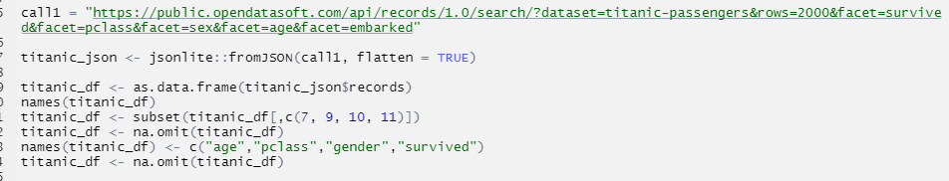
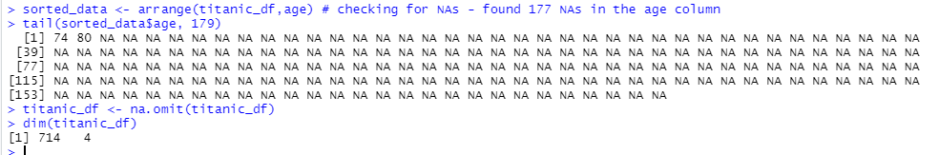
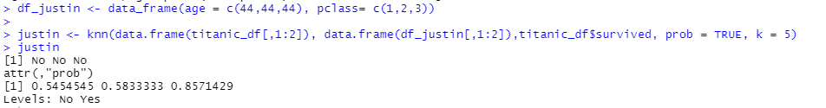
Q1 Titanic DS
Removed rows with NA for Age

Slide 4
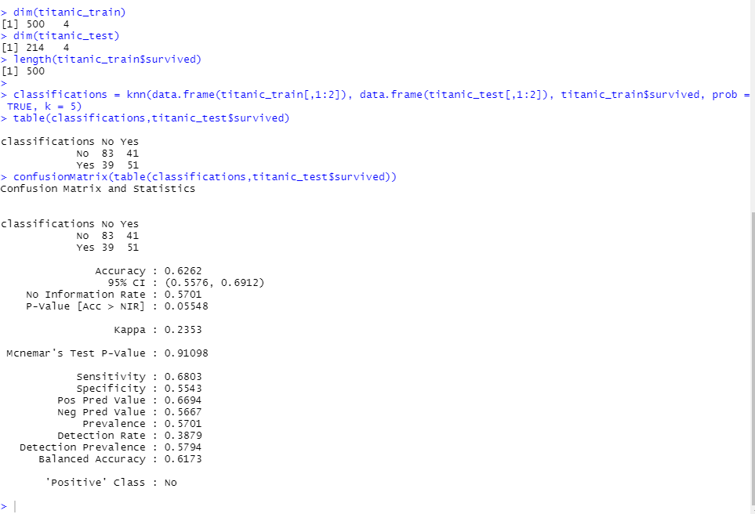

Q1 Titanic DS

Slide 5
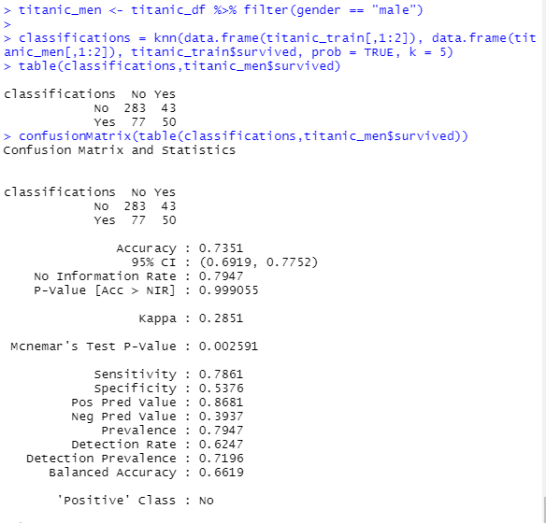
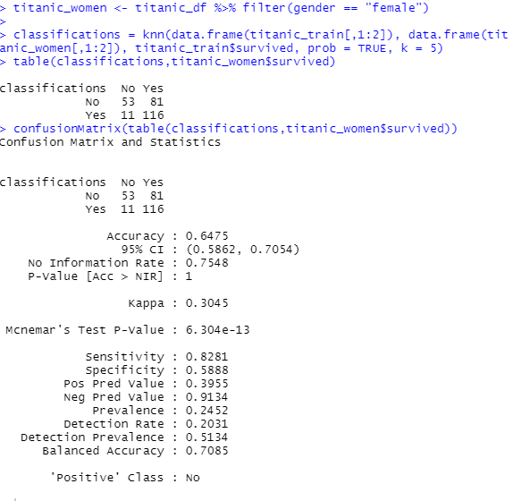
Q1 Titanic DS

Slide 6
For Live Session: Part 2 (3 – 4 hours)
a. For the full (multinomial) IRIS data (the iris dataset in R), do a 70-30 train/test cross validation with k =1 - 90 and use sepal length and width as predictors. Make a plot of k (xaxis) versus accuracy. Use this plot to tune the hyperparameter k. What do you feel is the best value of k?
BONUS: Repeat the above analysis with a leave one out cross-validation.

Slide 7
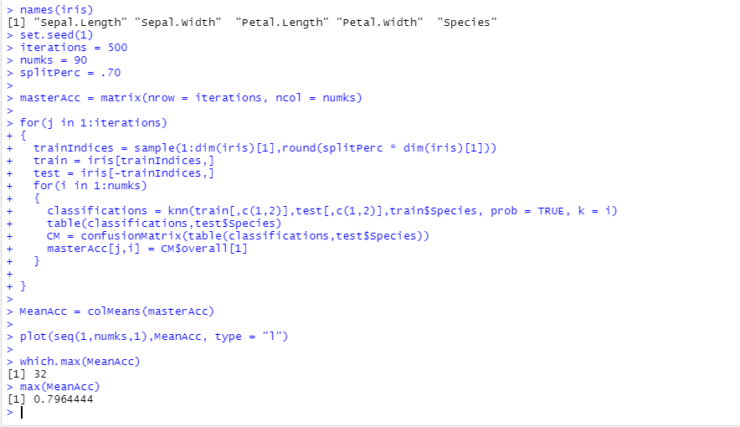
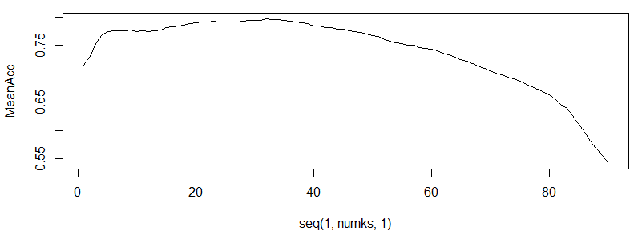
70/30 Train/Test Cross Validation
Best value of K = 32 with 79.64% accuracy

Slide 8
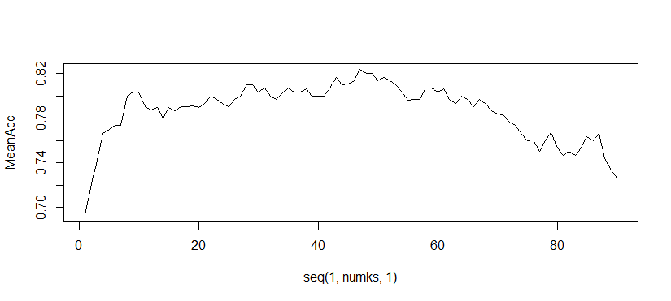
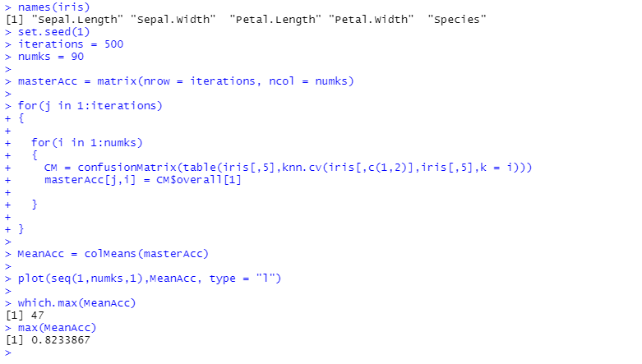
Leave one out cross validation
Best value of K = 47 with 82.34% accuracy

Slide 9

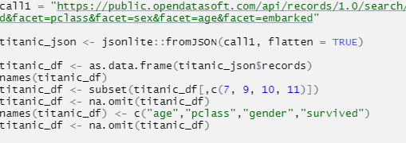
Part 3 - takeaways and questions
knn(train, test, cl, prob=FALSE {or TRUE}, k=?)
make sure the cl has the same length as train or it will haunt you!
make sure cl is a factor
table(objs that can be interpreted as factors…,
exclude = if (useNA == "no") c(NA, NaN),
useNA = c("no", "ifany", "always"),
dnn = list.names(...), deparse.level = 1)
Make sure your factors are the same length!
filter for just the columns you want
bump NA values
quick variable renaming

Slide 10
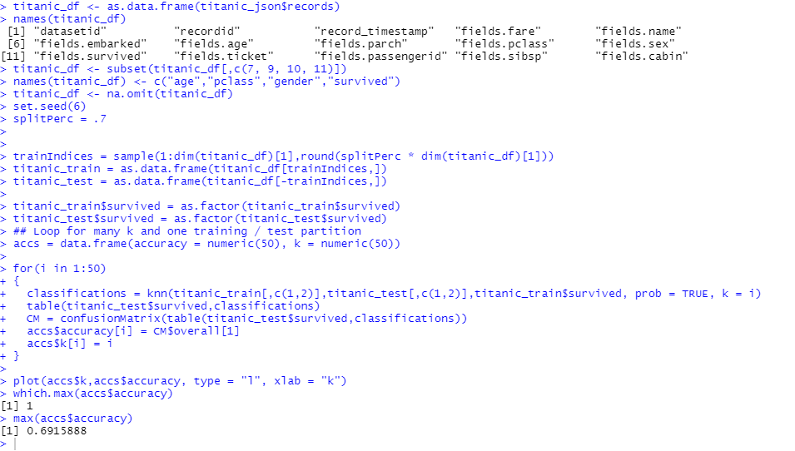
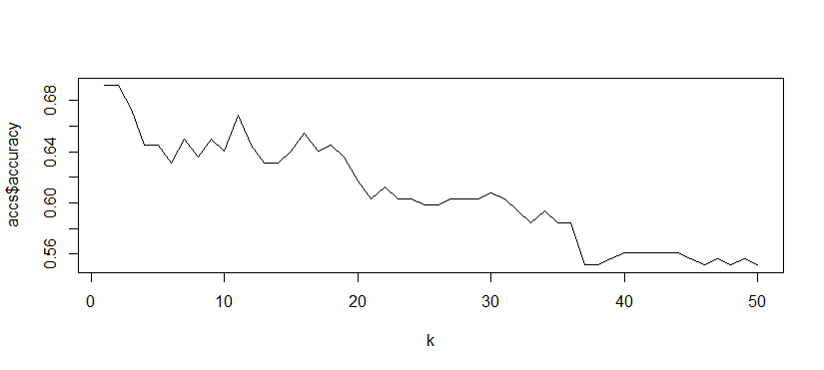
Part 3 - takeaways and questions
?

